Slide 1


EVERYONE IN THE WORLD IS UNIQUE
ECA project 2023-1-BG01-KA220-SCH-000160813

Slide 2
WHAT IS YOUR SPECIAL POWER
We are not heroes or full of abilities. But we all have different abililites we can do.
We are going to talk about them today
YOUR SPECIAL ABILITIES
What can you do?

Slide 3
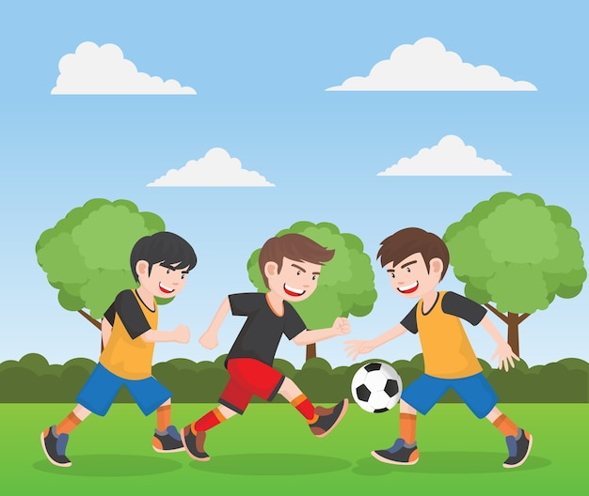
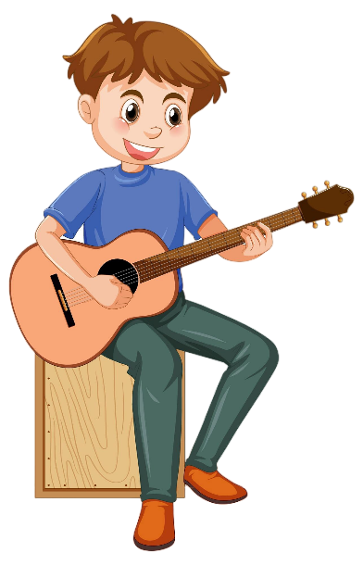

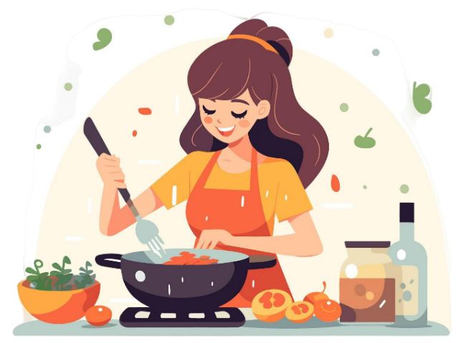

TELL US YOUR SUPERPOWER

Slide 4
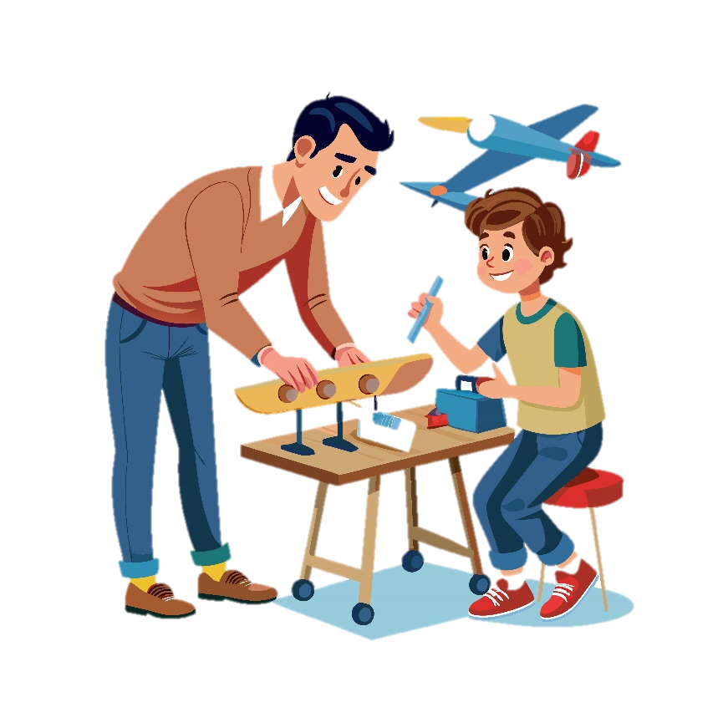
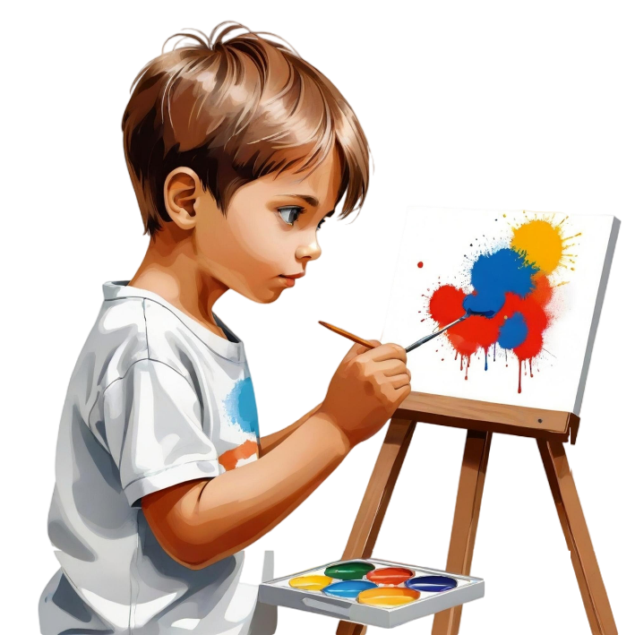


Slide 5


Slide 6
Everyone in the class has different abilities.
It is same in the life.

Slide 7
DO NOT FORGET THAT
YOU ARE ALL UNIQUE
YOU ALL HAVE SUPER POWERS

Slide 8




Module: Civic awareness
Sub-module: My identity
Topic: My Unique Me
Resource title: My superpowers
Credits: APDNE
2023-1-BG01-KA220-SCH-000160813
All media are within the EU intellectual property law.
Funded by the European Union. Views and opinions expressed are however those of the author(s) only and do not necessarily reflect those of the European Union or the European Education and Culture Executive Agency (EACEA). Neither the European Union nor EACEA can be held responsible for them.

